Slide 1
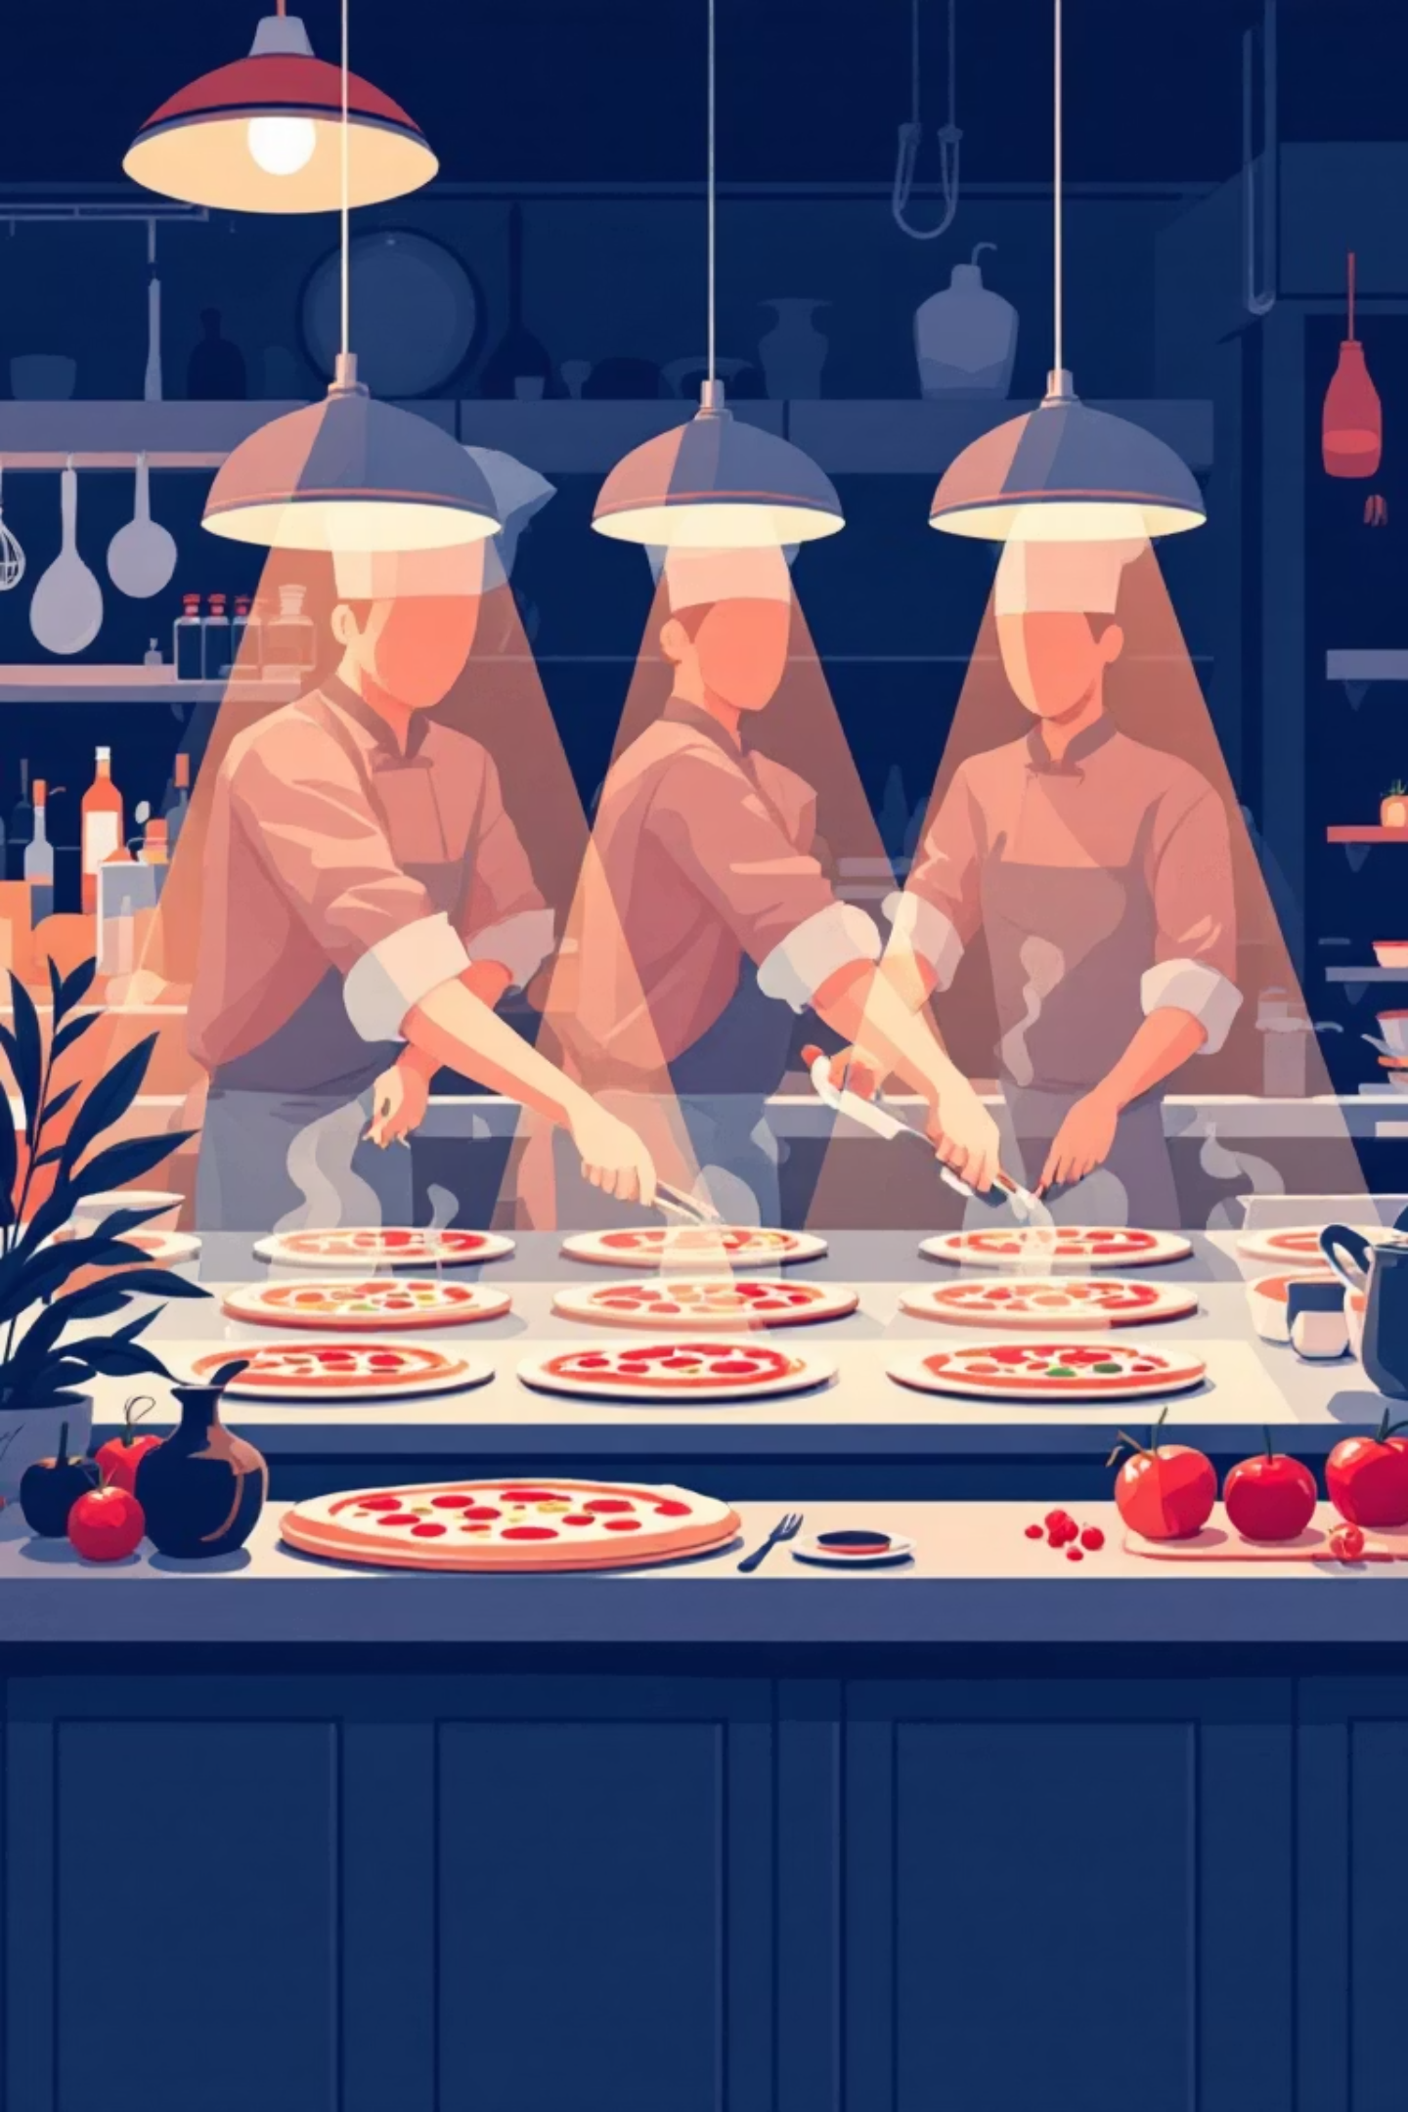
Pizza Sales Insights & Business Analysis
Understanding demand, product performance, and seating utilisation through data
We analysed pizza sales data using Python to uncover when we are busiest, how many pizzas we produce during peak hours, which pizzas perform best and worst, our average order value, and how efficiently we use our seating capacity.

Slide 2

Data & Methodology
Dataset Overview
Pizza sales transaction data including order ID, date, time, quantity, pizza type, and revenue. We grouped data by day, hour, and product type to extract meaningful patterns.
Tools & Technology
Python for data processing
Pandas for grouping & aggregations
Matplotlib/Seaborn for visualisations
Raw Data
Cleaning
Sales transactions
Data validation
Aggregation
Insights
Pattern extraction
Business actions

Slide 3
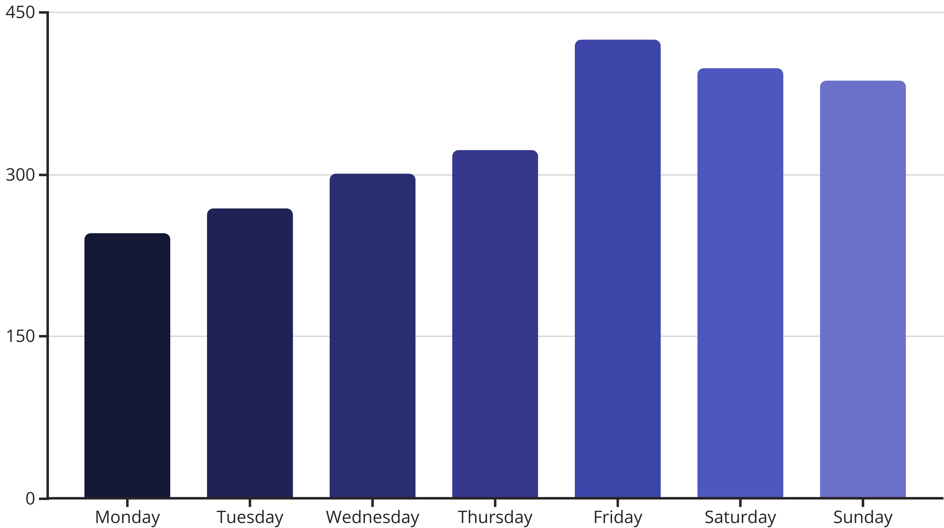
Busiest Days & Times
We grouped orders by weekday and hour, then counted transactions to identify peak service windows.
Weekend Rush
Lunch Peak
Staffing Focus
Orders spike on weekends, particularly Friday through Sunday evenings
Smaller but consistent peak during weekday lunch hours
These are critical service windows requiring optimal staffing

Slide 4
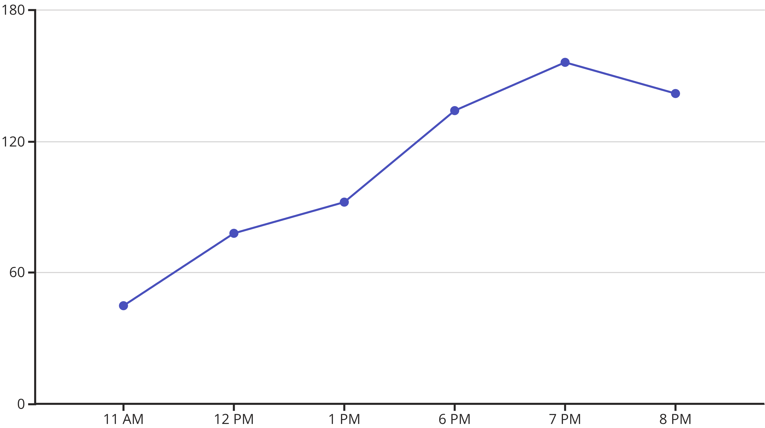

Peak Pizza Production
We summed the pizza quantities by hour to estimate kitchen output and identify production bottlenecks.
At peak evening hours, our kitchen produces 140-160 pizzas per hour, identifying crucial capacity planning needs and staff requirements.

Slide 5
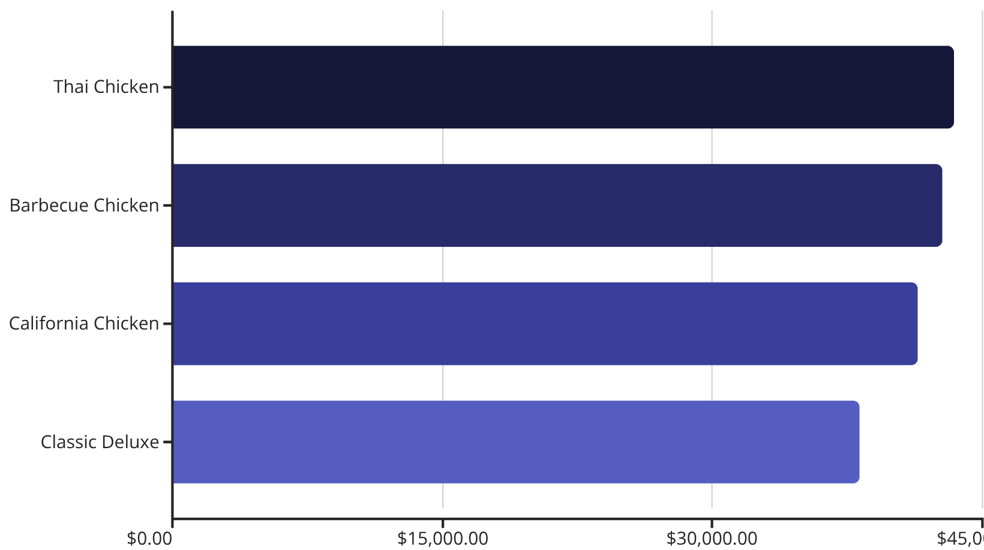
Menu Performance Analysis
We aggregated revenue per pizza type and ranked them to identify top and bottom performers.
🏆 Top Performers
⚠️ Underperformers
Brie Carre - ₹11,588
Mediterranean - ₹15,360
Spinach Pesto - ₹15,596
Calabrese - ₹16,925
Green Garden - ₹17,142
Action Required: Promote weak performers through marketing or consider menu redesign

Slide 6
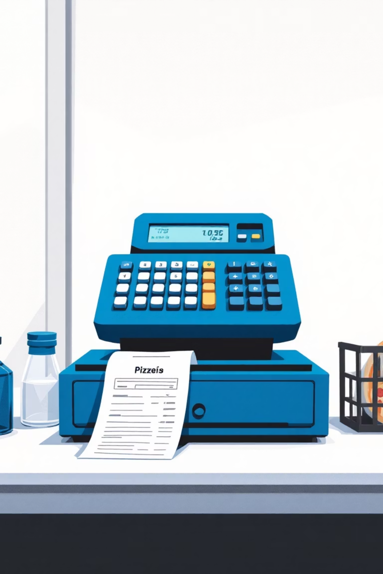
Average Order Value
₹38.31
2,346
₹89,893
Current AOV
Total Orders
Total Revenue
Total Revenue ÷ Total Orders
Analysed transactions
Overall sales value
This benchmark enables us to design effective upselling strategies, bundle offers, and add-on promotions to increase customer spend per visit.

Slide 7
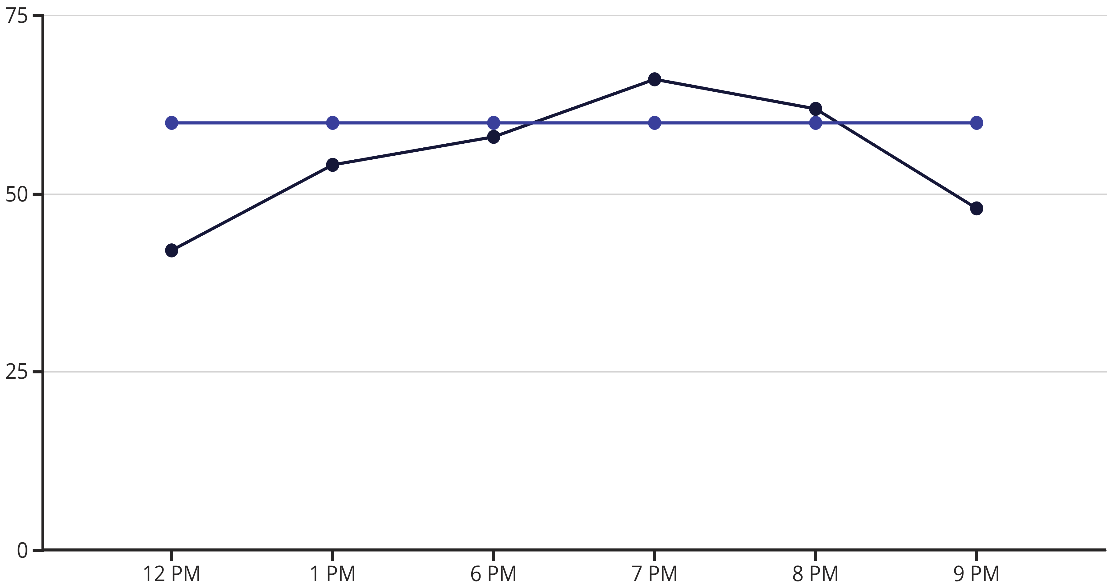

Seating Capacity Utilisation
We assumed 2 guests per order to approximate seats needed and compared against our 60-seat capacity.
Estimated Seats Needed
Seating Capacity
During peak evening rush (7-8 PM), demand approaches or exceeds 60 seats, indicating potential waiting times and need for efficient table turnover strategies.

Slide 8





Strategic Recommendations
Optimise Staffing
Increase staff during weekend evenings and weekday lunch peaks to handle demand surges effectively
Kitchen Efficiency
Prepare for peak output of 140-160 pizzas per hour with streamlined workflows and adequate prep
Menu Strategy
Promote underperforming pizzas through marketing campaigns or redesign recipes based on top sellers
Revenue Growth
Use ₹38 AOV benchmark to design bundle deals, combo offers, and strategic upselling initiatives
Capacity Management
Consider reservation systems or table turnover strategies during peak 7-8 PM window

Slide 9
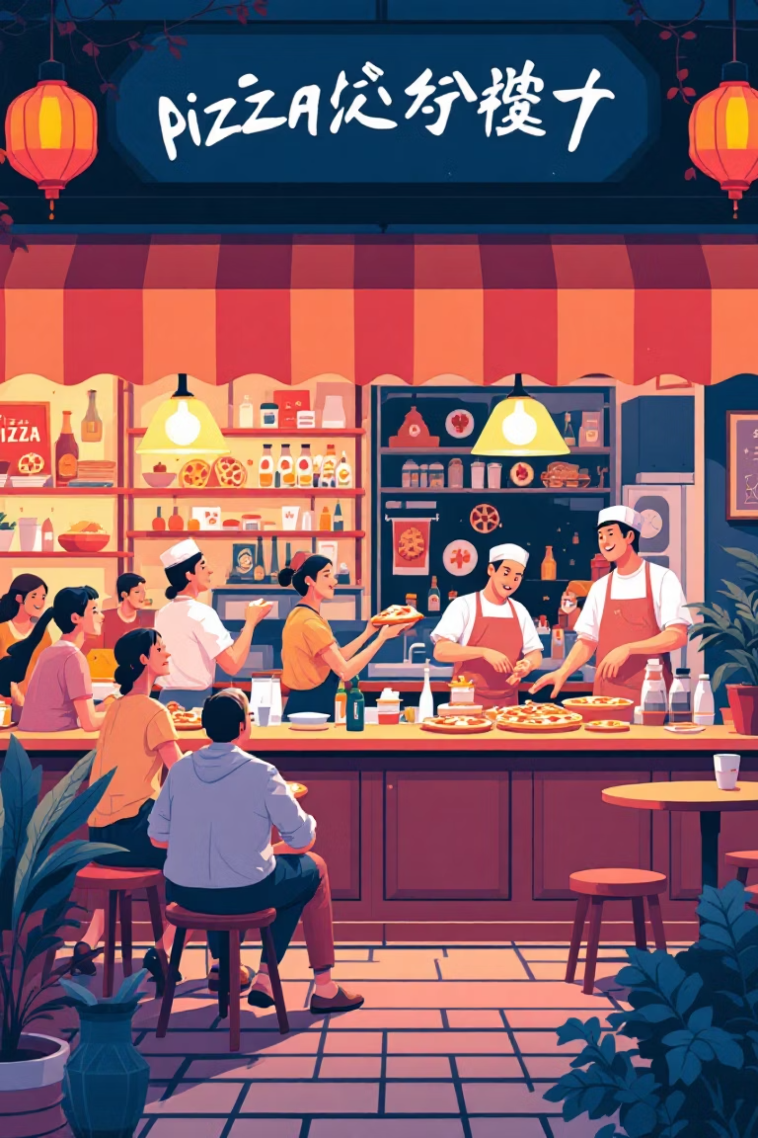
Turning Data into Action
This analysis bridges raw sales data with operational insights, enabling better staffing decisions, menu optimisation strategies, and enhanced customer experiences.
Data-Driven Decisions
Operational Excellence
Transform numbers into actionable business strategies
Optimise every aspect from kitchen to customer service
Competitive Advantage
Use insights to stay ahead in the restaurant industry

